Slide 1
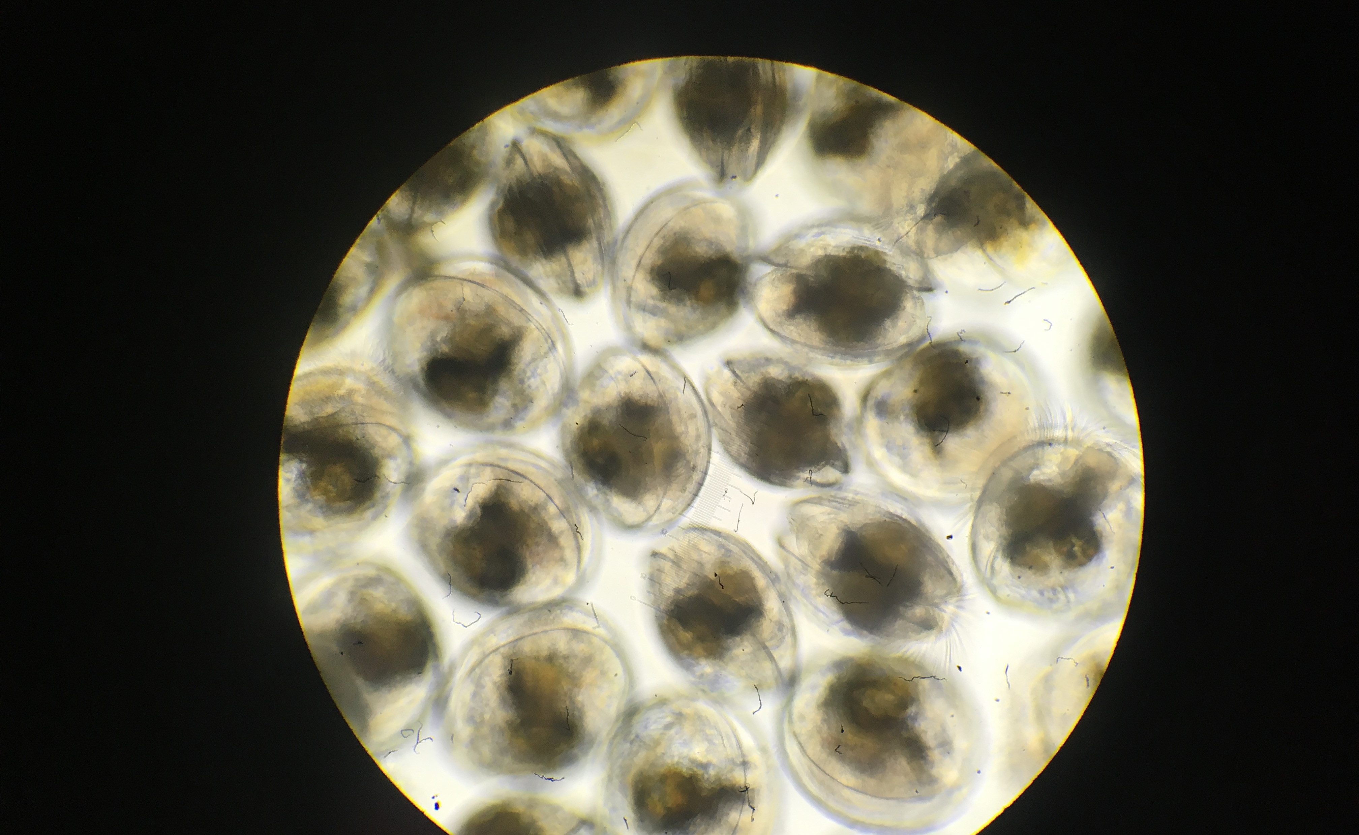
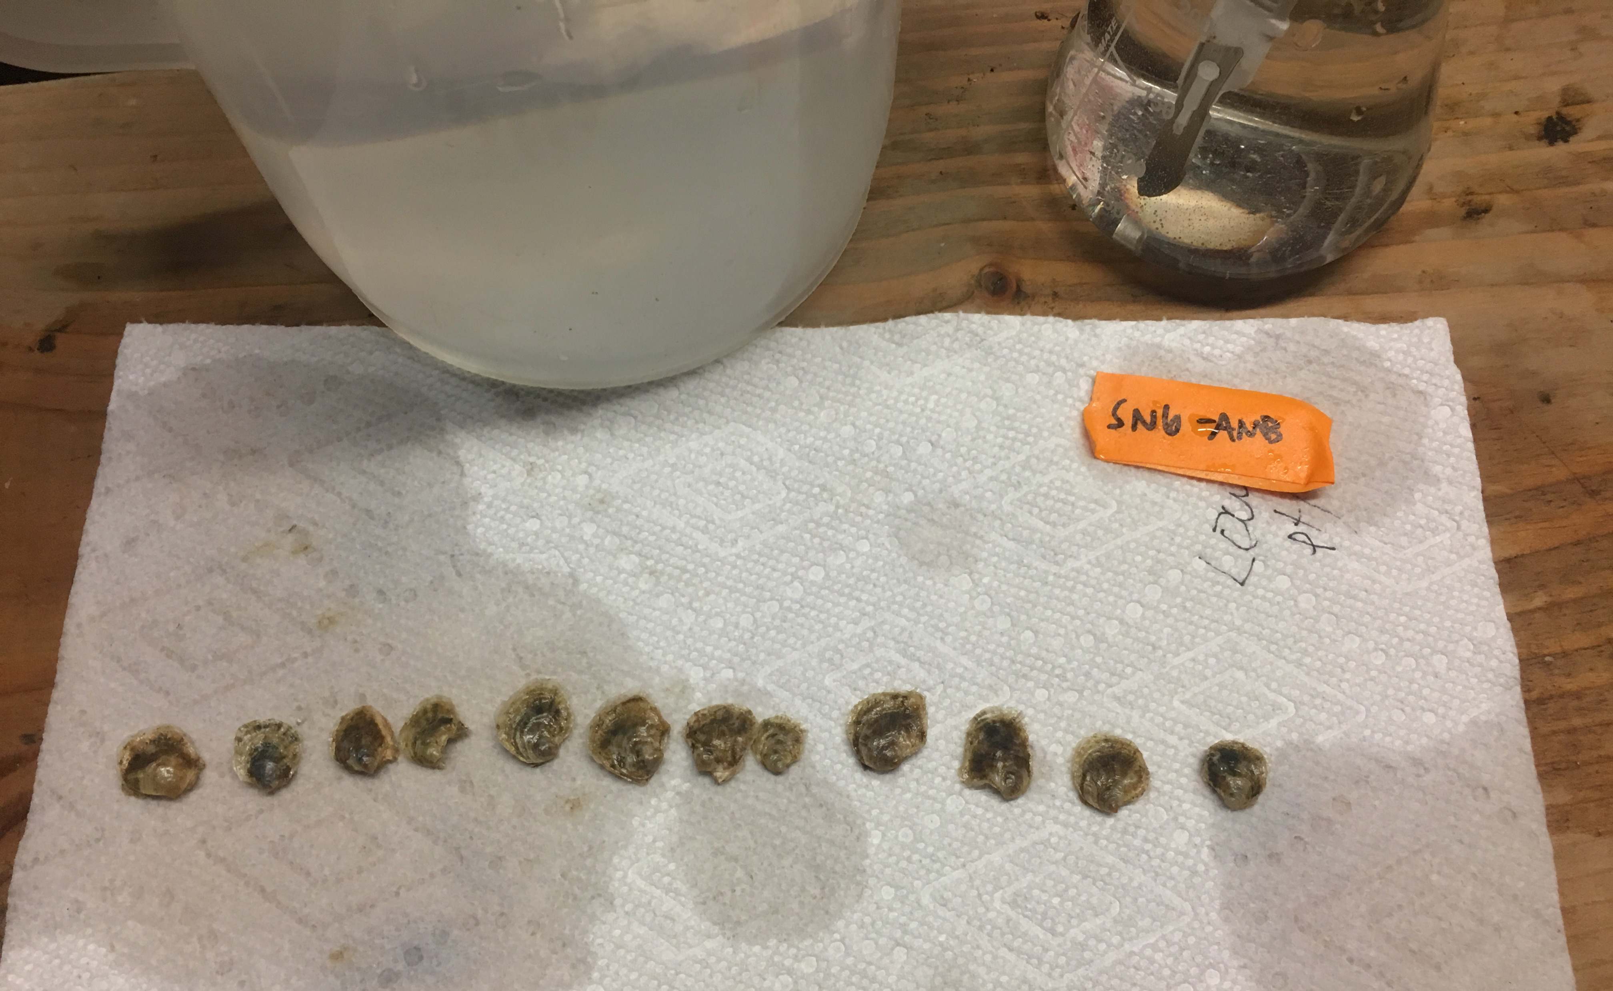
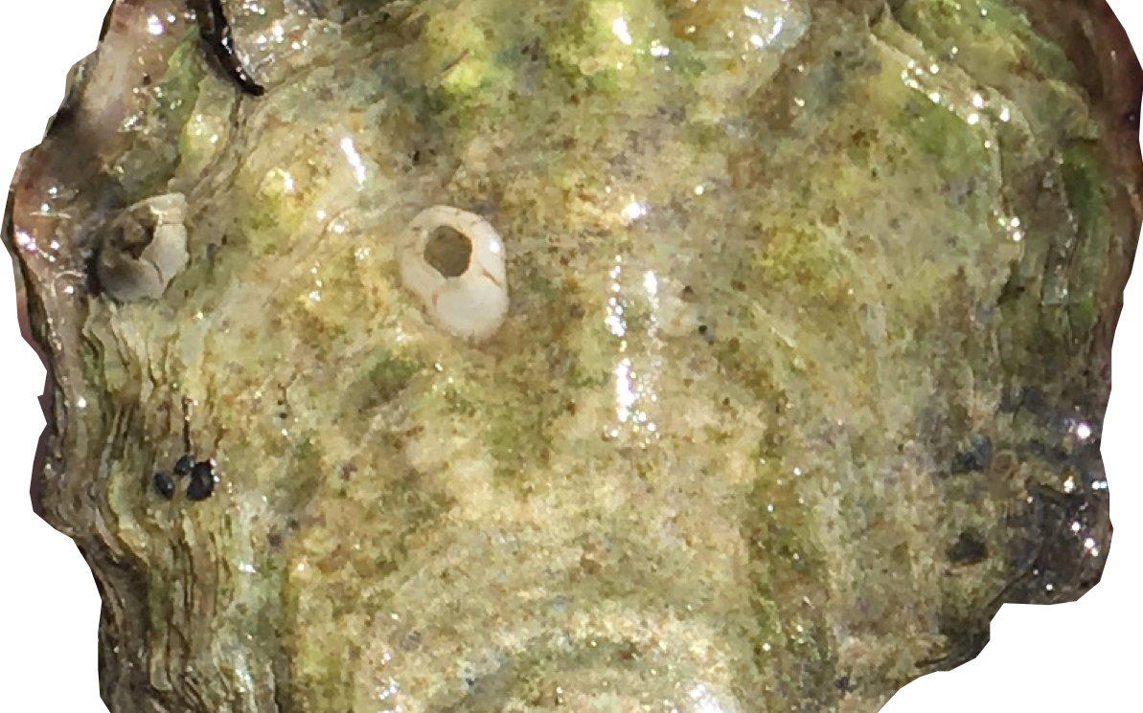
Olympia oyster
QuantSeq project
Data from …
3 populations
2 generations (3 life stages)
2 parental pCO₂ treatments

Slide 2
Analysis option 1:
Effect of high pCO₂ exposure on Olympia oyster physiology across generations, life stages, & populations
Adult HIGH
pCO2 exposure
Adult AMBIENT pCO2 exposure
VS.
2 generations, 3 life stages
3 populations
pCO2 exposure
Fidalgo Bay
Dabob Bay
Oyster Bay
Adults
Larvae
1-yr old offspring

Slide 3
Adult expression upon direct exposure to high pCO₂ (ctenidia tissue) - DEGs
Fidalgo Bay – 76 DEGs
Dabob Bay – 132 DEGs
One DEG in Oyster Bay, but not at all convincing

Slide 4
Varying amounts of growth during high pCO2 exposure

Slide 5
Enriched Biological Processes,
DEGs in Fidalgo Bay ADULTS exposed to high pCO2

Slide 6
Enriched Biological Processes,
DEGs in Dabob Bay adults exposed to high pCO2

Slide 7
Four genes were DEGs in both Fidalgo Bay & Dabob Bay upon high pCO₂ exposure
CYP2B4: Cytochrome P450 2B4
FABP4: Fatty acid-binding protein
Lipid transport
CYP2U1: Cytochrome P450 2U1
DIO3: Thyroxine 5-deiodinase
Hormone biosynthesis
& metabolic processes
pCO₂
CYP = response to oxidative stress, xenobiotics, hormone stuff. Common stress-response enzyme.
Notes:
CYP2B4: Cytochrome P450 2B4
FABP4: Fatty acid-binding protein
- Lipid transport protein in adipocytes.
DIO3: Thyroxine 5-deiodinase
- hormone biosynthetic process
- thyroid hormone metabolic process

Slide 8
Diff. expression upon exposure to high pCO2 - LARVAE - Global effects
All populations combined
Dabob Bay
Fidalgo Bay
Oyster Bay C1
Oyster Bay C2
inbred, offspring of C1
pCO2 exposure

Slide 9
Larval expression (pooled) upon parental exposure (only) to high pCO₂
DEGs
Global gene expression, all populations –
no pattern
One! (in Fidalgo Bay)
(Unknown function)
pCO2 exposure

Slide 10
Diff. expression upon parental exposure to high pCO2 - 1-yr olds - Global effects
All populations combined
Dabob Bay
Fidalgo Bay
Parental pCO2 exposure

Slide 11
Could survival differences during field deployment relate to parental pCO₂ exposure influencing gene expression?
Global Gene Expression
Dabob Bay
Survival ~1 yr old offspring in field differed by parental pCO2
Fidalgo Bay
Fidalgo Bay Dabob Bay Oyster Bay F1 Oyster Bay F2
= ambient parental pCO2
= high parental pCO2

Slide 12
HOWEVER … there’s a catch.
Each population / treatment group is genetically distinct.
PCA biplots from SNPs
each color = population + parental pCO2 group

Slide 13
And there are many siblings.
Dabob Bay
Fidalgo Bay
Half sibs (same father)
half sib (same father)
full sibs
Half sibs
(same mother)
half sibs (same mother)
X
Full sibs
Only include Fidalgo Bay non-sibs in 1-yr old DEG analysis

Slide 14
5 DEGs that common among all 4 NON-SIBS sample combinations
Not all that impressive to me
Helicase with zinc finger domain 2
One annotated – BP include
nuclear-transcribed mRNA catabolic process
positive regulation of transcription
regulation of lipid metabolic process

Slide 15
Analysis option 2: Gentotype-dependent expression differences among populations, life stages of Olympia osyter
Fidalgo Bay
Fast growing & larger
Dabob Bay
Smaller
Resilient larvae
Black in color
Oyster Bay C1
High reproductive output
3 populations (four cohorts)
2-3 life stages (adult, larvae, 1-yr old)
Oyster Bay C2
(inbred, from C1)

Slide 16
Diff. expression by population - Adults
Global
DEGs
No. of DEGs among cohorts, Adults
Dabob Bay
689
1,107
Fidalgo Bay
450
Oyster Bay C1

Slide 17
Diff. expression by population - Adults
All DEGs from pairwise comparisons

Slide 18
Diff. expression by population - Larvae
Global
DEGs
No. of DEGs among cohorts, Larval offspring
Dabob Bay
296
254
162
Fidalgo Bay
762
Oyster Bay C1
182
0
Oyster Bay C2

Slide 19
Diff. expression by population - Larvae
All DEGs from pairwise comparisons

Slide 20
Diff. expression by population – 1-yr offspring in field
Global
DEGs
No. of DEGs among populations
Fidalgo Bay
1182
Dabob Bay

Slide 21
Diff. expression by population – 1-yr offspring in field
Note: Fidalgo Bay & Dabob Bay only, 1,182 DEGs

Slide 22
Extra slides

Slide 23
Diff. expression upon exposure to high pCO2 - ADULTS - Global effects
All populations combined
Dabob Bay
Fidalgo Bay
Oyster Bay
pCO2 exposure

Slide 24
NON-SIBS only, Fidalgo Bay, DEG analysis – 4 possible sample combinations
Combination 1 – 8 DEGs
Combination 2 – 8 DEGs
Combination 3 – 15 DEGs
Combination 4 – 30 DEGs

